Slide 1
Customer Demographic Data Analytics
Practical Excel Data Analytics Project
Prepared by: Faysal Mohamed Dahir
Course: Excel for Data Analysis | August 2026
Raw Data > Clean Data > Formulas > PivotTables > Charts > KPIs > Slicers > Dashboards > Findings

Slide 2
1. Dataset
Why Raw_Data exists, and why Clean_Data is used for analysis
Dataset: Customer Demographic Data Analysis Data. Purpose: understand customers by city, gender, occupation, income, and registration date.
Raw_Data — original source (do not modify)
Clean_Data — working dataset for analysis
Purpose: keep the original data unchanged.
300 records as received from the course.
7 variables: Customer_ID, Registration_Date, Gender, Age, City, Occupation, Monthly_Income.
Contains duplicates, blanks, N/A, NULL, Unknown, and dash (-).
Not used for totals, PivotTables, charts, or dashboards.
Purpose: cleaned data used for all analysis.
293 records after removing 7 duplicate / empty rows.
Same 7 variables plus helpers: Gender_Clean, City_Clean, Occupation_Clean, Income_Level, Reg_Year, Reg_Month.
Missing Age and Income filled with averages.
Used for Analysis, PivotTables, charts, KPIs, and both dashboards.

Slide 3
2. Data Cleaning
Duplicates removed after investigation | Missing values handled by data type
Duplicates (7.1)
Missing values (7.2) and text cleaning (Part C)
Exact duplicates removed: CUS00026, CUS00040, CUS00075, CUS00095, CUS00143, CUS00194, CUS00224.
CUS00049 investigated: one incomplete row and one complete row.
Two fully empty rows deleted.
Blank Customer_IDs left blank — no fake IDs created.
Result: 300 rows became 293 clean records.
Found as blank, N/A, Unknown, NULL, and dash.
Registration_Date labelled Missing — no fake dates.
Gender, City, Occupation labelled Missing— not filled with mode.
Age blanks replaced with average age (~44).
Monthly_Income blanks replaced with average $923.87.
TRIM, PROPER, SUBSTITUTE (CS became Civil Servant).

Slide 4
Missing values by column (Raw_Data)
Use this table when you present: this column had this many missing records.
Column | Missing (Raw_Data) | What was missing | How it was handled
Customer_ID | 15 | Blank cells | Left blank — no fake IDs
Registration_Date | 20 | 19 blank + 1 Unknown | Labelled Missing — no fake dates
Gender | 17 | Blank cells | Replaced with Missing
Age | 16 | Blank cells | Replaced with average (~44)
City | 17 | 16 blank + 1 dash (-) | Replaced with Missing
Occupation | 15 | Blank cells | Replaced with Missing
Monthly_Income | 20 | 18 blank + 1 Unknown + 1 dash | Replaced with average ($923.87)
Total original records: 300. After removing 7 duplicate/empty rows, Clean_Data has 293 records.

Slide 5
3. Formulas (Analysis sheet)
Basic calculations | Conditional functions | Logical functions | Date functions
Basic
Conditional
Logical
Date
SUM, AVERAGE, COUNTA, MIN, MAX Total income: $270,693 Average income: $923.87 Average age: 44.2 Customers: 293
COUNTIF and AVERAGEIF Mogadishu customers: 110 Female average income Teacher average income: $704
Nested IF and IF + AND Income_Level: High >= $1,500 Medium $800 to $1,499 Low < $800
TODAY, NOW, DAY, MONTH, YEAR, DATE, NETWORKDAYS Reg_Year and Reg_Month added on Clean_Data

Slide 6
4. PivotTables
All four areas used: Rows, Columns, Values, Filters
Source: Clean_Data only. Raw_Data was never used as a Pivot source.
Rows: City, Occupation, Income_Level, and Reg_Month.
Columns: Gender in the City x Gender pivot.
Values: Count of customers, Sum of Monthly_Income, Average of Monthly_Income.
Filters: City filter on the income-level PivotTable.

Slide 7
5. Charts (more than 5)
Created from PivotTables, not from hundreds of raw rows
Total Income by City (column) — Mogadishu $111,504.
Customer Registrations by Month (column) — peak in May.
Income by Occupation (column) — Business Owners highest total.
Gender x City (clustered column).
Sum of Income by Gender (pie).
Yearly Total Income (pie) — 2025 vs 2026.
Income Level Distribution (pie) — High, Medium, Low.
Customers by Occupation (column).

Slide 8
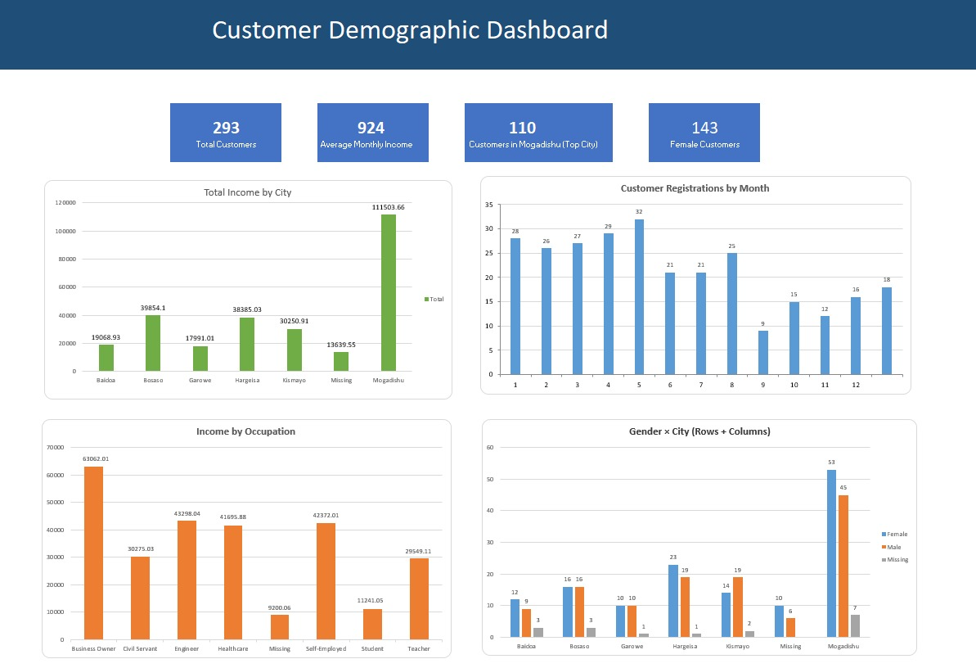
6. Dashboard 1 — Customer Demographics
KPIs: 293 customers | $924 average income | 110 Mogadishu | 143 Female

Slide 9
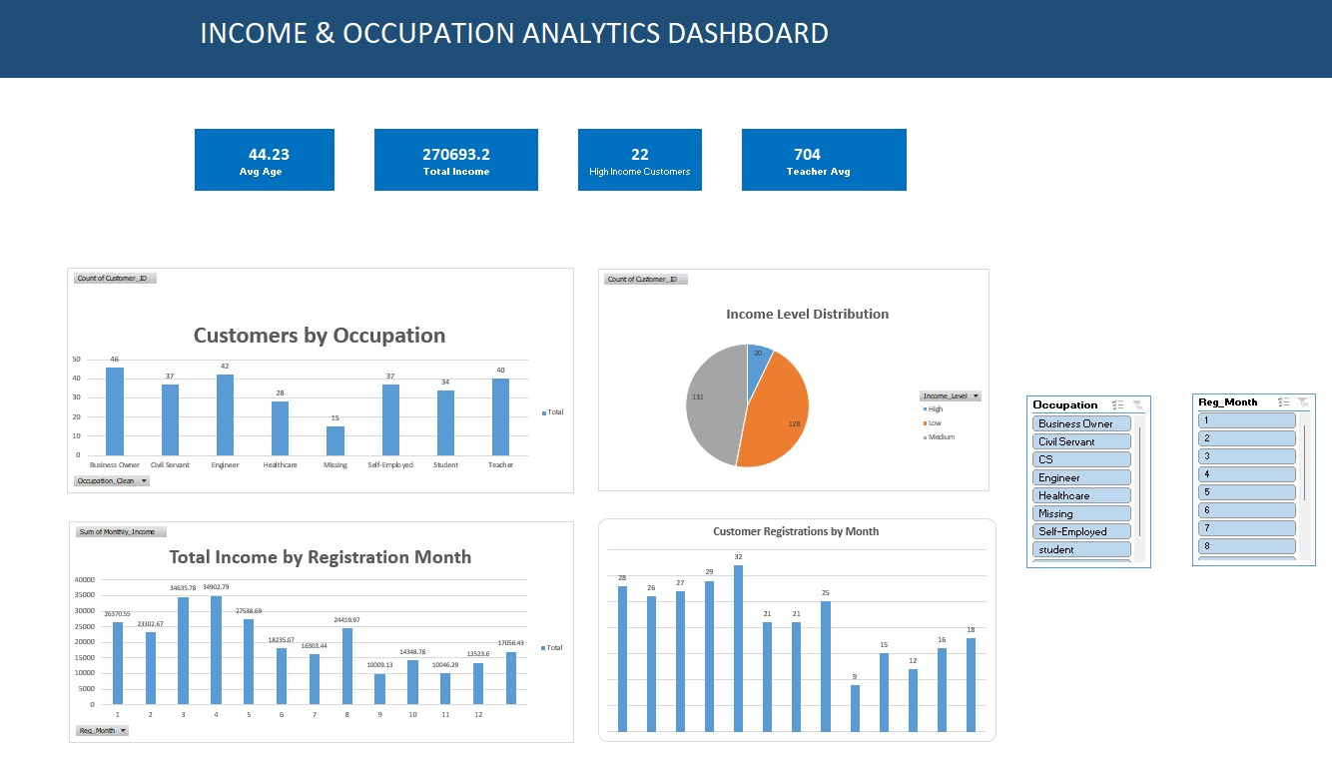
7. Dashboard 2 — Income and Occupation
KPIs: Age 44.23 | Total income $270,693 | 22 High income | Teacher avg $704

Slide 10
8. Findings
Five insights from Clean_Data, PivotTables, and dashboards
1. Mogadishu has the largest customer base (110) and the highest total income ($111,504), about 41% of all income.
2. Average monthly income is $923.87 and average customer age is 44 years.
3. Female customers (143) slightly outnumber Male customers (133), with similar average incomes.
4. Most customers are Medium or Low income. Only 22 customers are High income ($1,500 or more).
5. Business Owners and Healthcare workers have the highest average incomes. Registrations peaked in May (33).

Slide 11
9. Recommendations
Three actions based on the findings
1. Focus on Mogadishu
2. Target Female customers
3. Design by income level
Put marketing and customer retention on Mogadishu. It is the largest city in the dataset and generates the highest revenue.
Build campaigns for Female customers in major cities. They are nearly half of the customer base.
Create offers for Medium and Low income customers, and grow the High income group (only 22 customers today).

